Slide 1
Prague, 15 May, 2017
Notes:
EEG

Slide 2
Children in institutions
Across the EU , at least 500.000 children are growing up in institutional care, although this is likely to be an underestimation. There a no official figures (Children in Alternative Care, Eurochild, 2010).
We define institutions as segregating residential care facilities for children without parental care.
impersonal and depersonalising
imposing a rigid routine
lack of attachment and affection (block treatment)
do not allow the individual care and attention indispensable for a child to thrive
The consequences are devastating for children, destroy families and deliver a heavy cost to society in the long term.
Reference: Deinstitutionalisation and Quality Alternative Care for Children in Europe, Lessons Learned and Way Forward, Eurochild, 2014.
Notes:
Figure of 500.000 comes from Children in Alternative Care, Eurochild 2010.
SIZE!!!

Slide 3
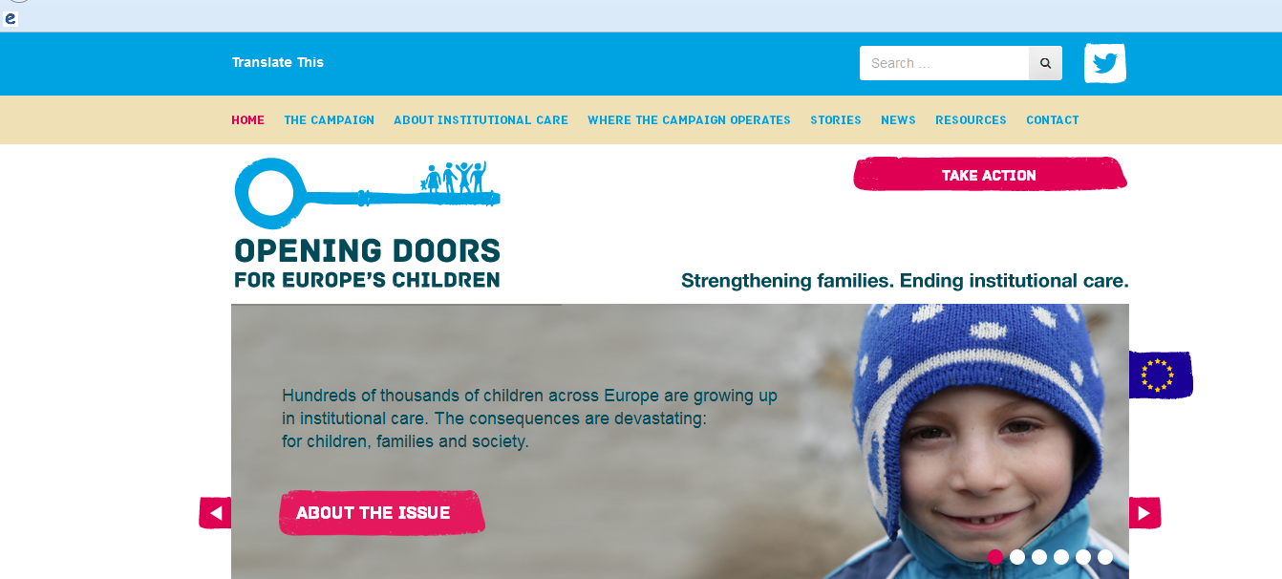
The Opening Doors Campaign Phase II
Strengthening Families – Ending Institutional Care.
Calling on the EU and national governments to prioritise the transition from institutional to family-based care
Putting children back at the heart of Europe’s child protection systems
Notes:
I will now introduce you to one of the Campaigs that Eurochild coordinates and it actually also runs in Poland. The Opening Doors for Europe’s Children Campaign has been running since 2013 and it advocates for the Strengthening of families and the end of institutional care. We are calling on the EU and national governments to prioritiae the transition from institutionall to family base care. The Campaign ran between 2013-2015 between 2 international partners Eurochild and Hope and Homes for Children and in 12 mainly Central European countries. The Campaign is now entering its 2nd Phase and Eurochild and Hope and Homes for Children have partnered with 3 more international partners. SOS Children’s Villages, FICE and the International Foster Care Organisation. The updated website with updated country pages will be online by beginning of December.

Slide 4
Where the Campaign Operates
Notes:
The Campaign runs in 15 European countries – 3 of them in Western Europe. Our interest has also shifted in these countries in an effort to break the myth that institutional care only takes place in Central Eastern European countries. It is also a matter of quality and follow up. So in countries that have actually proceed and completed DI reforms we are advocating for keeping high standards of quality in care but also and we are advocating for the mainstreaming of services for all children. For example in Austria there are approximately 10,000 unaccompanied children that are oftern institutionalized – Institutional care is a practice that has stopped in the last 30 years for Austrian children but we see that it has re-started for refugee and migrant unaccompanied children. This is a discriminatory practice.

Slide 5
Overarching Goal
The Opening Doors for Europe’s Children campaign aims to support national efforts to develop child protection systems that strengthen families and ensure high-quality family- and community-based alternative care for children, by leveraging EU funding and policy and building capacity in civil society.

Slide 6
Alternative Care in Hungary, Bulgaria& Belgium Policy & Practice
Special Focus:
Children with disabilities in institutional care
Children in institutional care 0-3 years old
Family & Community based care

Slide 7
Children with disabilities
Hungary:
Children segregated from society
Children are lagging in institutional care
Lack of inclusive education READ QUESTIONNAIRE
Bulgaria:
2016: all institutions for children closed, 2,382 children in 253 FTPCs
FTPCs are seen as a permanent alternative to larger institutions, children are still excluded
Belgium:
Children are treated based on medical model
90% of children in institutions in Flanders are children with disabilities
Limited access to inclusive education
Notes:
Hungary, new type of institutions for children with multiple and complex needs also accommodate children with disabilities or those having severe illness

Slide 8
0-3 years old children in institutional care
Hungary:
Legislation prohibits institutional care for 0-6 years old.
However, 289 children 0-3 in 3 institutions
Bulgaria:
Despite the decrease, 726 children under the age of 3 in institutional care
Belgium:
Social hospitalization of children 0-3 years old
No legislation, no DI strategy prohibiting institutional care of children 0-3 years old. SEE INTERNAL REPORT

Slide 9
Family & community based care
Hungary
Family based care:
Foster care is a priority: Foster care families in isolation, not monitored, no access to services
Community based care:
In 2015 41 SGHs, 200 in total. SGHs isolated, with no access to services, untrained staff, not able meet children’s complex needs
Belgium
Family based care:
Foster carers not supported
Benefits have decreased/ foster carers do not have access to services
Community based care

Slide 10
Learn more:
Follow us on Twitter!
@openingdoors_eu

