Slide 1
Historický vývoj systému péče o ohrožené děti v ČR
Kulturgeschichte Ostmitteleuropas mit Schwerpunkt Geschichte der ČSSR
Fachbereich 8/ Institut für Geschichtswissenschaft
2. kulatého stolu VP a DAR
„Transformace systému péče o ohrožené děti
z pohledu dětí a dalších odborníků“
Frank Henschel
Post-Doc Researcher
Fellow of Fritz-Thyssen-Foundation
University of Bremen
fhensche@uni-bremen.de

Slide 2
Development of State Childcare in Postwar Czechoslovakia
1950: Abolition of Foster Care (Pěstounské Péče)
Report of Ministry for Social Affairs
Exploitation of foster children as workforce
Missing school attendance
1947: Law of Youth Welfare (48/1947 Sb.)
Nationalization of home system
Abolition of public-private Okresní Péče o mládež / Okresni Starostlivosť pro mládež
1951: Restructuring
Abolition of Ministry for Social Affairs
Ministry of Health Care
1) Kojenecké Ústavy 2) Dětské Domovy 1-3 let
Ministry of Education
1) Předškolní Dětské Domovy 2) Školní Dětské Domovy
Frank Henschel
fhensche@uni-bremen.de

Slide 3
Aims and Presumtptions of State Childcare
Healthcare and Nutrition for Babies and Infants
(Ideology) and Education for older Children
Strict age limits of home institutions
Babies (0-1)
Infants (1-3)
Preschool (3-6)
School (6-10/15)
Residential Care was considered equal or even superior to family care.
Frank Henschel
fhensche@uni-bremen.de

Slide 4
Regulations of Home Admittance
→ No general, juridical basis, but random resasons to take children away from parents
E. g. Neglect, Bad Parenting, School problems, Violence, Suspicious Lifestyle (especially of Mothers)
→ Report at Národní Výbory
by parents themselves, by teachers or caretakers, other family members, colleagues)
→ Investigation → State Custody → Confirmation by court
→ Examination of Children in “Záchytné Dětské Domovy“
Segregation of disabled /difficult children in special homes
Frank Henschel
fhensche@uni-bremen.de

Slide 5
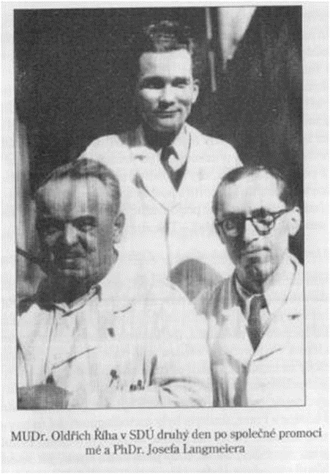
Dimensions and Criticism
→ 1965 ca. 17.000 “normal”, 3.000 “difficult”, 10.000 “disabled” children in residential care
→ Since late 1950s: Studies on Deprivation (Matějček and Langmeier)
→ 1960s: “dětská otázka” – professional and public pressure for reform
→ Stated deficits: (1) large groups, (2) less educators, (3) isolated homes,(4) missing alternatives like adoption and foster care
Frank Henschel
fhensche@uni-bremen.de

Slide 6
Reform and Restructuring
→ New Family Law 1964 (94/1963 Sb.)
Home child free for Adoption after “one year of missing interest” by parents
→ New Home Types:
Family-like Homes for long term admittance (small groups, permanent educators),
SOS-villages (nationalization 1973)
Boarding-school homes for short-term admittance
→ Re-Introduction of foster care by law 1973 (50/1973 Sb.)
Frank Henschel
fhensche@uni-bremen.de

Slide 7
Děkuji vám srdečně za pozornost!
Kulturgeschichte Ostmitteleuropas mit Schwerpunkt Geschichte der ČSSR
Fachbereich 8/ Institut für Geschichtswissenschaft
Frank Henschel
Post-Doc Researcher
Fellow of Fritz-Thyssen-Foundation
University of Bremen
fhensche@uni-bremen.de

